Slide 1

Statistics Canada Data Exercise
- 18th July 2022
Notes:
Good Afternoon everyone, Thank you for your time today and giving me this opportunity. The statistics Canada data exercise included 5 tasks using different technology stacks. For this exercise I used Python, Excel and Power BI.

Slide 2
Data Ingestion & Pre-Processing
1) Dataset 1 : Aboriginal People & Dataset 2: Income for the year 2016
2) Using Python - Pandas
3) Analysis of Dataset (Excel & Pandas)
Checking any wrong, Not Applicable, Not available, Unreliable, confidentiality restricted, null, blanks and redundant data, etc
4) Performed Data Pre-processing
Removed redundant information – used Member ID information
Renamed the column names
No deletion of any data
Four-Region calculations: 5 digit to be considered as a subset code; used ‘ALT_GEO_CODE’
Scope – Functionalize code
Notes:
First task was of the data ingestion and pre-processing on the 2 datasets – 1 of Aboriginal People data & 2nd of Income for the year 2016
I used pandas library in Python for the data ingestion and stored it as a dataframe.
The main focus was on understanding the data and analysing is using pandas & excel.
I checked if there were any wrong, Not Applicable, Not available, Unreliable, confidentiality restricted, null, blanks or redundant values and treated them accordingly.
In the metadata there were codes mentioned for , Not Applicable, Not available, Unreliable, confidentiality restricted – which helped to analyse the data quickly.
There wasn’t any significant observation here except that there was around 16% of data for Intuit category as not applicable –
I didn’t delete those records because it holds some significance and 16% of data is a significant number had it been <1/2% records one could have consider to delete it to clean the dataset more.
Further in pre-processing I removed the redundant columns and renamed the remaining ones. I feature engineered the feature for Four Region model on the basis of Geo codes.
For some records geo codes weren’t complete so I used the4 Alt_Geo_code feature. The approach was that for say any code as 10001 the first 2 digits are 10 – which represent the province Newfoundland & Labrador then it comes under it and then the region was decided as Atlantic Canada.

Slide 3
Four-Region Model Calculations
1) Total Population – Income Statistics Member ID = 1
2) Total Average Income – Income Statistics Member ID = 5
3) Average Total income = Total Income/ Total Population
4) Filtered Age = 1 as its Total Age for part d.
Notes:
The second task included calculating metrics like prop of Population of ab vs non-ab, Total avg income for both the categories, prop of male vs female population as per ab & non-ab and then calculating the age group having max aboriginal population.
For this I initially used group by but I wanted to store all my results in a single dataframe format so I created a new dataframe and used filters to calculate these metrics and stored them as a list on the go to finally store in the df. From the data when we select the Income statistics Member ID = 1 we get the population metrics and for 5 we get the total average income.
So using that I calculated the metrics and For average I used 2 approaches – 1 with taking average for all the provinces directly 2nd to calculate individually as ) Average Total income = Total Income/ Total Population. For the age group category member id = 1 represents the total age so I filtered that out in my query

Slide 4
Heatmap- Aboriginal Population & Region
Notes:
For the third task, I used seaborn library to create the heatmap for ab vs region.
I captured these results in a separate df and created a pivot table to generate the same else it would have been represented as a 4x2 map

Slide 5
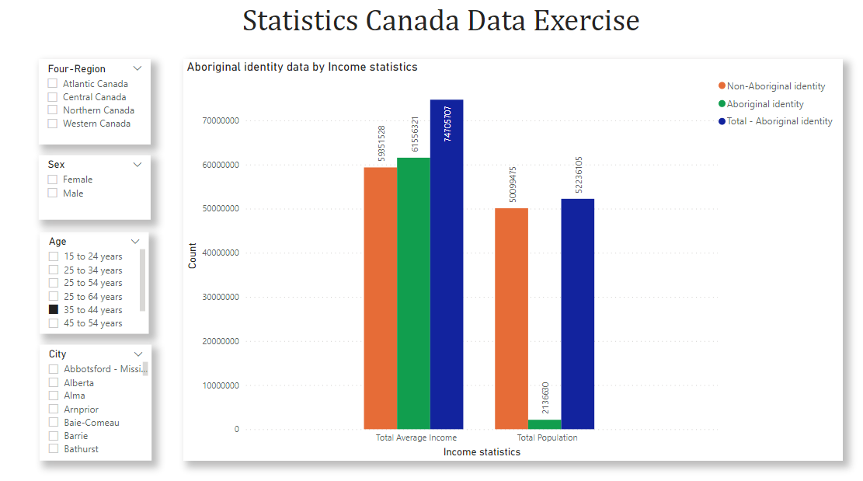
Power BI Visualizations * Scope - Use Scotia Templates
Notes:
For 4th task, it was asked to create interface where users can visualize the population and Average Total Income by selecting the Dimensions like -Canadian Region based on Four Region model,“Aboriginal Identity” vs. “Non-Aboriginal Identity”,Sex,Age group and City.
I used Power BI to create a dashboard/ page where the bar graph shows the average total income and the population for – ab, non – ab and the total population
Which can be filtered on the basis of the four regions, sex, age groups and the city.
A scope for this task is using scotia template color codes and the logos but I wasn’t sure of the confidentiality restrictions and used the standard color codes for now.

Slide 6
Merging of Datasets
1) Limitations of Resources – Memory/Space issue
Local system
Google Colab
2) Workaround – Taking subset of Datasets
Issue – Inconsistent results
3) Total Population – 2015 : No data, Income for 2015 and population data of 2016
Notes:
In the 5th & the last task we had to merge the 2 datasets and calculate Population for “Aboriginal Identity”, Population for “Non-Aboriginal Identity” and Total population in 2015 in high income group (after-tax income >= $70,000) where an earner is present in the household by Canadian province.
For merging the 2 datasets I used the merge feature from pandas and joined them as inner join on the ALT-GEO_CODES. The 2 datasets were huge and merging them was giving more huge dataset and it gave error. I tried it on my local system as well as on Google colab but it didn’t worked out.
So as a workaround I took a subset of dataset with only 2 provinces : 10 as Newfoundland & Labrador and 11 as Prince Edward Island.
Had we have taken a random sample there will be inconsistent results.
Further using the filters I calculated these metrics. One of the issues for calculating the total population in 3rd part was it mentioned year 2015, we don’t have any data for that so I evaluated it for the year 2016.

Slide 7
Any Feedback, Demo or Q&A
Link: https://github.com/ShivanikaShah/Statistics_Canada
Notes:
I’ll now showcase the demo for Power BI visuals and do a code walkthrough. Please let me know if you any questions or feedback.

Slide 8
Thank you!
- Shivanika shah

